Slide 1
2020 JUDGES’ SYMPOSIUM & WORKSHOP
Under the directorship of SACC’s Independent Judges Network Panel of Judges

Slide 2
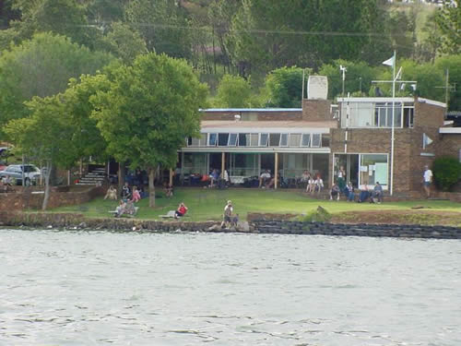
The Venue
This year’s event was held at the Pretoria Sailing Club off Nellmapius Drive, south east of Pretoria. The club and its grounds are on the shores of the Rietvlei Dam which is within the Rietvlei Nature Reserve, the largest urban Nature Reserve in South Africa.

Slide 3
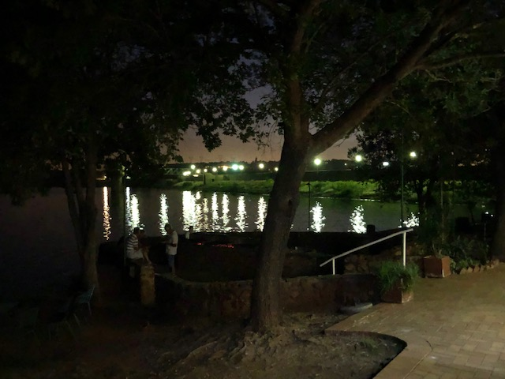
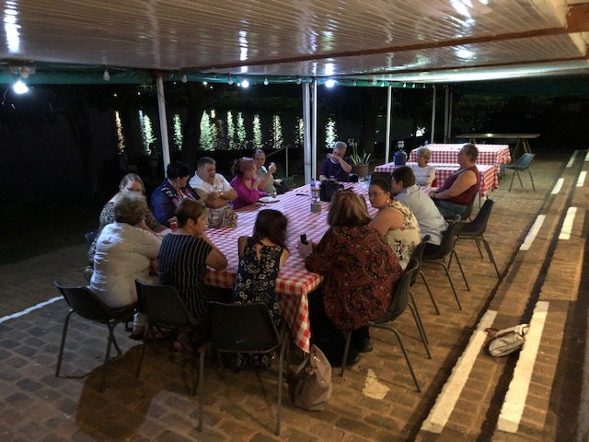
Venue at night
The lights reflecting off the dam make for a magical experience for the SACC Judges who attended the Symposium and Workshop.
The Judges relaxing around the table.

Slide 4
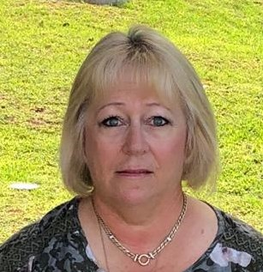



The Team
Rita Wiseman ,Chairperson of Judges’ Council and Treasurer of the Independent Judges Network Panel.
Shirley Addison, Secretary of Judges’ Council and Chairperson of the Independent Judges Network Panel.
Daniel Germishuys, Judges’ Council Member and Secretary of the Independent Judges Network Panel.
Dina Freitas, Judges’ Council Member and Member of the Independent Judges Network Panel.

Slide 5




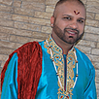
Presentations given by:
Ingrid de Wet
Ingrid is a senior judge and tutor from the Gauteng Panel of Judges.
Elizabeth van Renen
Elizabeth is a senior judge from the Gauteng panel of Judges.
Jan van Rooyen
Jan is a senior judge and tutor from the KwaZulu Natal Panel of Judges.
Karen Pepler
Karen is a senior judge and tutor from the Gauteng Panel of Judges.
Lashan Moodley Singh
Chairperson and Speciality Judge from the KwaZulu Natal Panel of Judges.

Slide 6
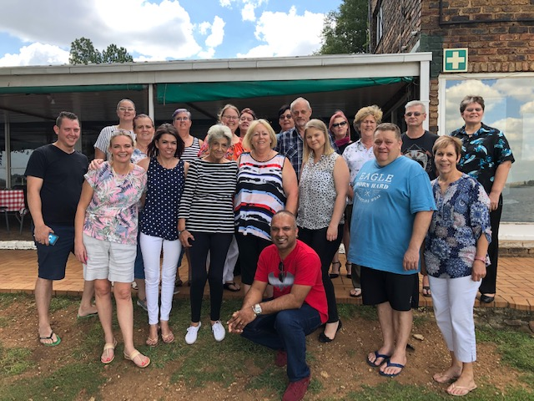
Judges & students who attended the Symposium and Workshop

Slide 7
Judge’s feedback
Thank you to IJN panel members for a lovely symposium. A really productive two days and lovely to be together again. Thanks for the lovely meals we had right through the 2 days. Hard to beat in future. May everyone arrive safely home.
From the Ingrid de Wet, GPJ.
Home!! Thanks everyone for a really great weekend. Special thanks to all the speakers for presentations that must have taken hours of preparation and to IJN for all the planning and hard work that was going on in the background
From Jane Goble, KZN Panel
Thanks IJN for a fabulous seminar and also to everyone who did presentations. Really an enjoyable weekend.
From Gail Nel, KZN Panel
Thanks a ton, IJN, for a wonderful weekend filled with information, great company and fabulous food and fun!
From Karen Pepler, GPJ
Thank you IJN for a good meeting & symposium, well done.
Elizabeth van Renen, GPJ
Absolutely I agree! See you all on the show bench.
Natasha Greaves, KZN Panel

Slide 8
More Judge’s feedback
Thank you it was indeed a good weekend I am so proud to be part of a great team of judges who have incredible knowledge. Thank you to all who made this weekend the success it was. A great start to the show year
Rita Wiseman, IJN
Share in the sentiments expressed... Definitely a great start to the show year... Now to apply the teachings
Lashan Moodley, KZN Panel
Thank you so much to the fabulous team (IJN) who made this weekend such a great success. Wonderful company, delicious food and lots of very useful information and sharing of ideas
Ingrid van Eck Gain, CPJ
Thank you so much IJN. Proud to be part of the group and learnt a lot. Lovely venue and excellent hosts.
Landie Copperthwaite, CJI
I would like to thank my panel for the well organized and the
outstanding people that attended the meet .food great presentation outstanding atmosphere and all also for the fun
Dina Freitas, IJN

